Slide 1
DDA, ATL05, and python

Slide 2
test_dda_bif.f90 (Jeff Lee)
Reads ATL03 and creates DDA_bif testdata (ATL05)
Run base DDA
Density (for each photon)
Slabs
Thresholds ( -> signal mask)
Run DDA Bifurcate (If two peaks found in waveform)
bif_thresholds (top and bottom masks)
bif_surfaces (top and bottom surfaces)
ponds (pond characteristics, if test passed)

Slide 3
test_dda_bif.f90 (Jeff Lee)
Base DDA
Density
compute density of each photon by measuring distances to nearby photons
Slabs
Noise and Signal Slabs, masked at photon rate
Compute center of Signal Slab by finding histogram max for each segment
Noise Slab defined as photons within height range above Signal Slab
Thresholds
Threshold Mask and Signal Mask
Threshold Mask: density[Signal Slab] > max(density[Noise Slab]) + thresh_offset
Any photon above maximum density within Noise Slab should be Signal (hopefully)
Signal Mask: density[Threshold Mask] > quantile(density[Threshold Mask])

Slide 4
test_dda_bif.f90 (Jeff Lee)
DDA Bifurcate
Only run if two peaks detected
If one surface, Signal Mask Top = Signal Mask Bottom
Set is_multi to TRUE (photon rate)
Compute bif_beg and bif_end (distance)
bif_thresholds
Determine Top and Bottom Peak Heights, and Valley Height (minimum histogram bin between peaks)
Signal Mask Top
Contains Signal Mask photons between Valley Height : Top Peak Height + (Valley Height – Bottom Peak Height)
Signal Mask Bottom
Contains Signal Mask photons between Valley Height : (lowest non-zero histogram bin)

Slide 5
test_dda_bif.f90 (Jeff Lee)
DDA Bifurcate
bif_thresholds
Signal Mask Top
Signal Mask Bottom
bif_surfaces
Compute top and bottom surfaces using DDA surface algorithm
ponds
Compute pond characteristics if:
sufficient bottom measurements
mean surface NOT higher than that of the edges
NOT a significant difference in height of edges
along-track start, center, end
top height, max depth, min depth
pond classified as ‘good’ if max_depth > 0.5 m

Slide 6
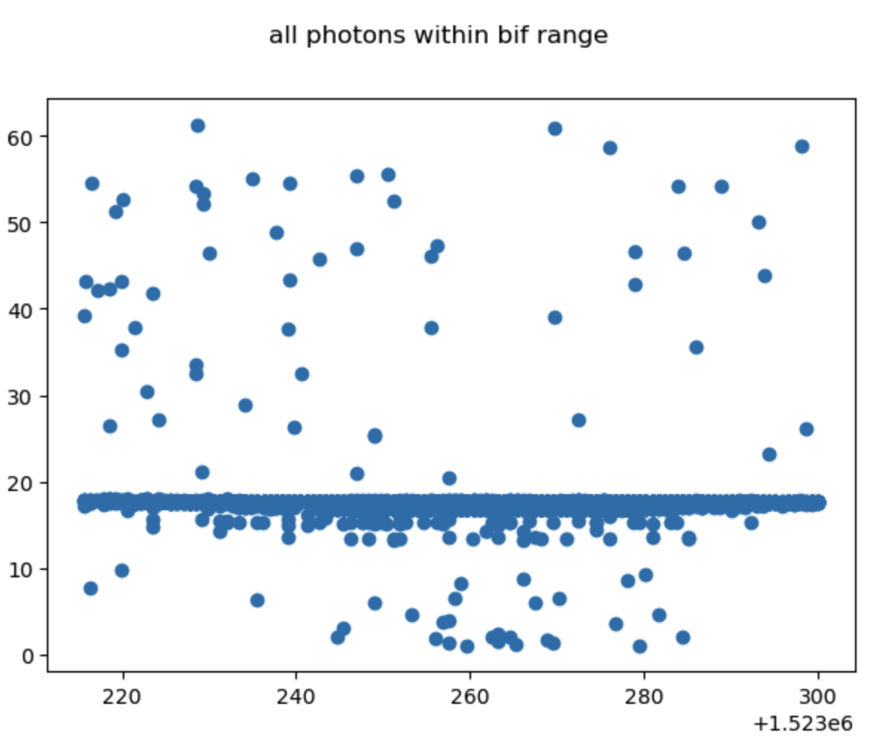

Slide 7
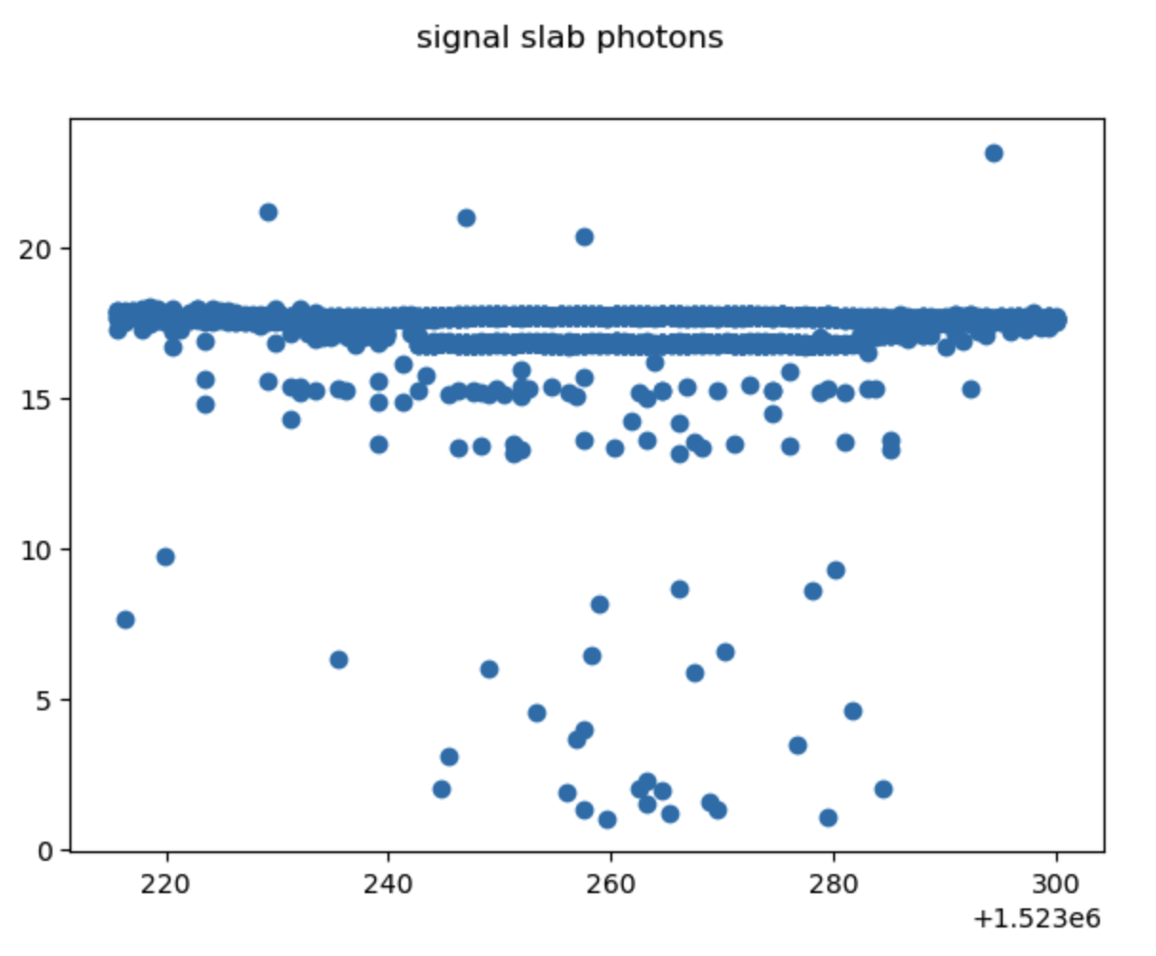

Slide 8
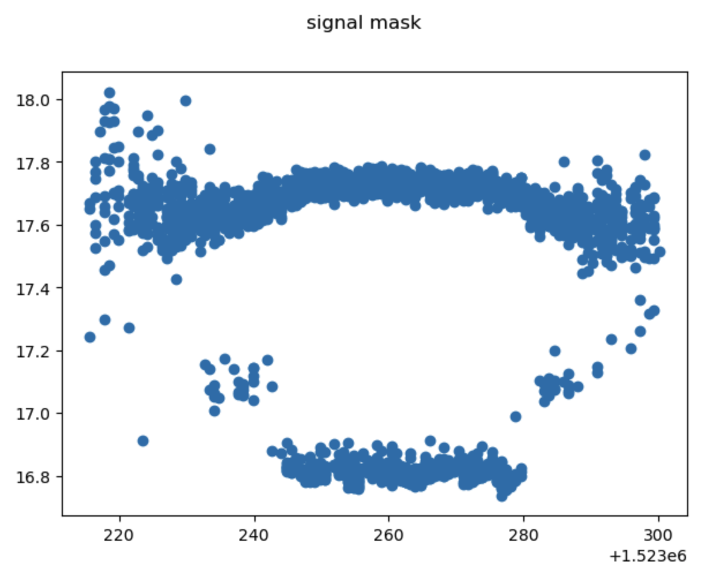

Slide 9
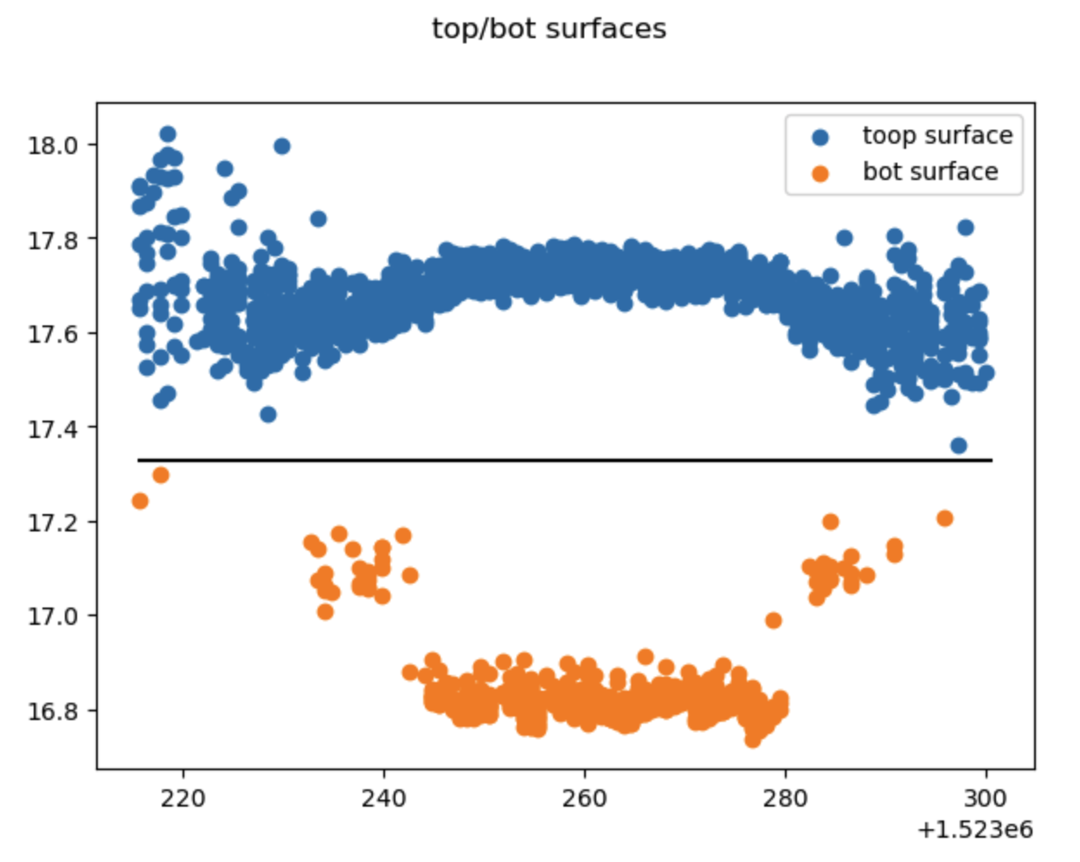

Slide 10
ATL05
ATL05 includes photon height, time, along-track distance, and DDA computed density
Contains sub groups for:
surface_top/bot
ponds
bif_segments

Slide 11
ATL05
Parameters to run fine_track
photon heights
photon along-track distance
signal mask
computed in DDA-threshold
(Should be easy to recreate with ATL03)
surface_top/bot mask
computed in BIF-threshold
bif_beg/end mask
within bif_segments subgroup
contains beginning/end along track distance of bif_segments

Slide 12
dda_run.py
set time range (t0, t1)
read ATL05
count BIF segments within time range
loop through BIF segments

Slide 13
dda_run.py
For each BIF segment
Create masks for top and bottom photons
signal_mask > 0
signal_top/bot > 0
x_ph within bound bif_beg : bif_end
Compute coarse mean and fine track window for top and bottom segments
mean of masked photon heights
top window: top_coarse - bif_middle/2 : top_coarse + 3.5
bottom window: bot_coarse – 2.0 : bot_coarse + bif_middle/2
bif_middle = bot_seg_coarse + (top_seg_coarse – bot_seg_coarse) / 2
(Should I just be saving Valley Height?)
Collect photons into two windows, coarse_top and coarse_bottom

Slide 15
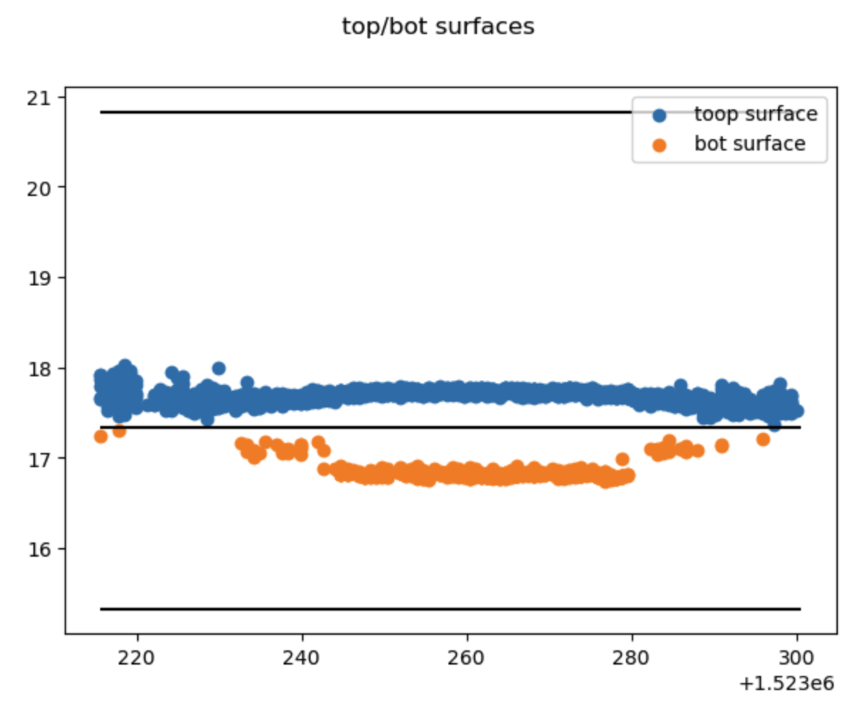

Slide 16
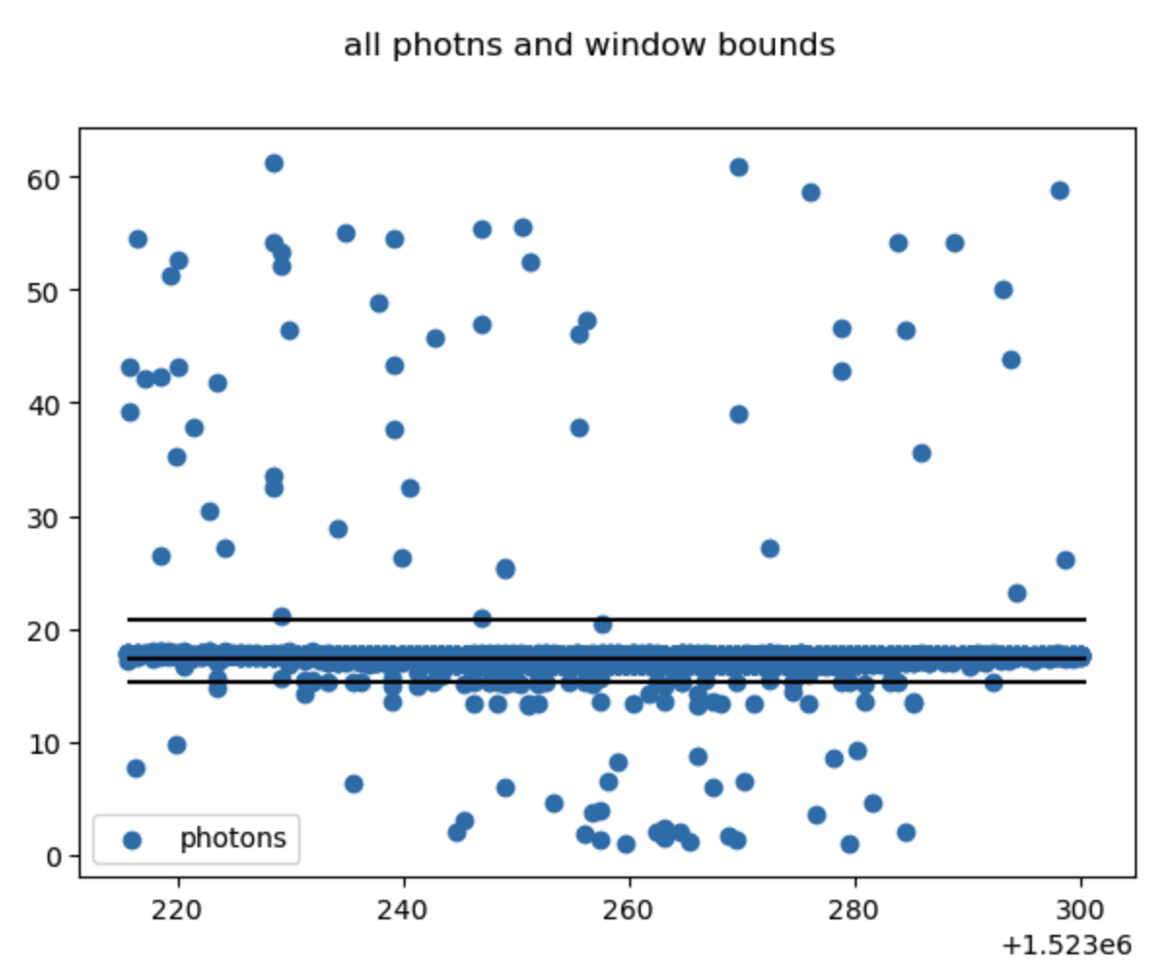

Slide 17
dda_run.py
For each BIF segment
For both top and bottom surfaces:
Collect 150 photons and call fine_track to compute surface height
advance at half steps

Slide 18
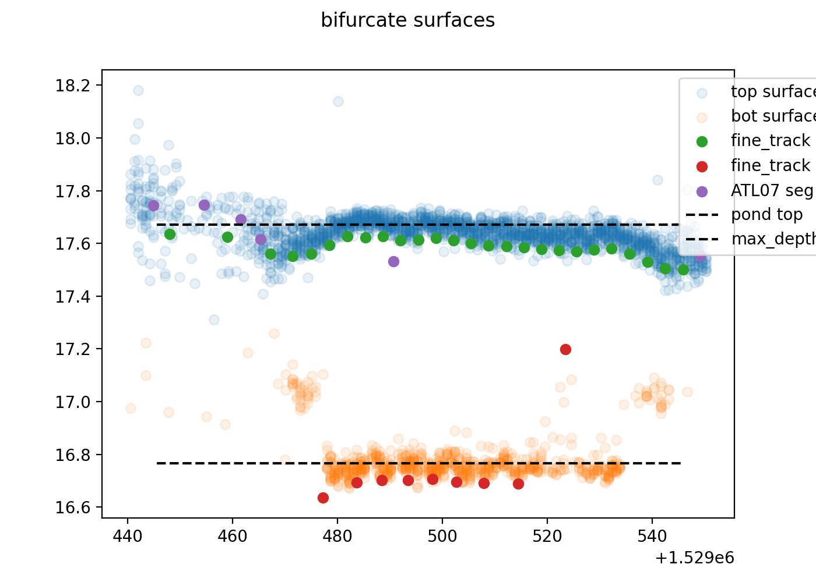

Slide 19
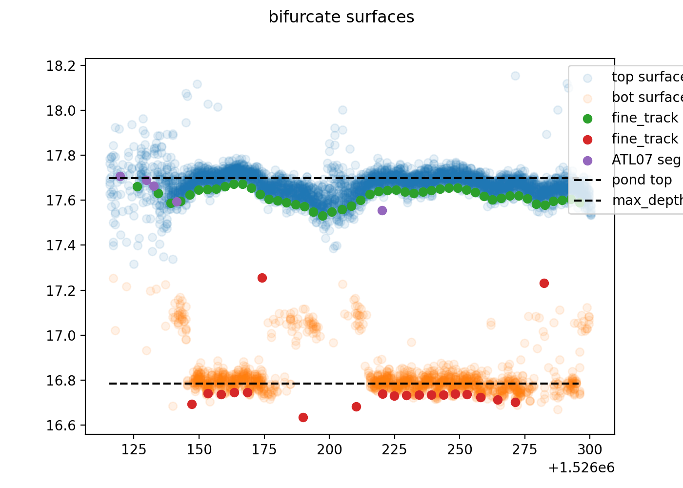

Slide 20
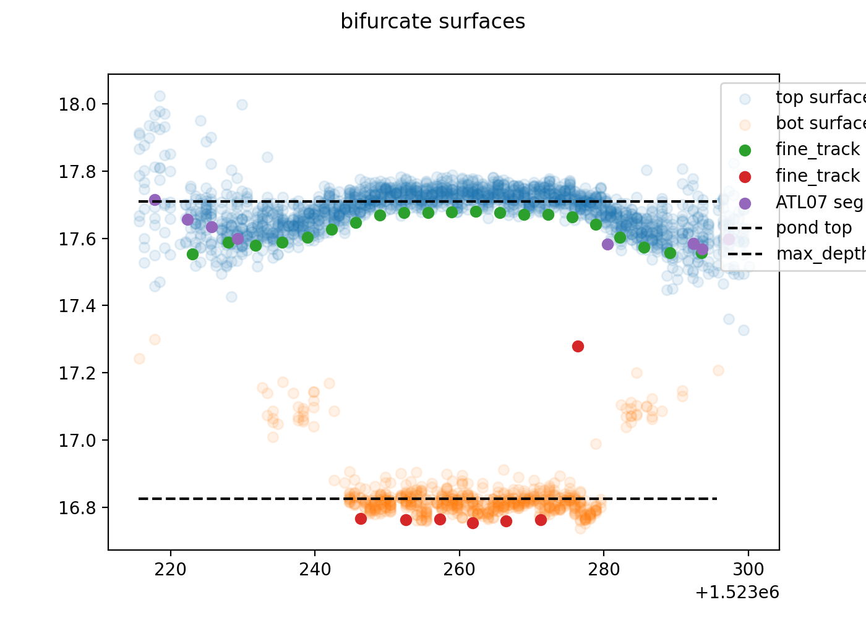

Slide 22
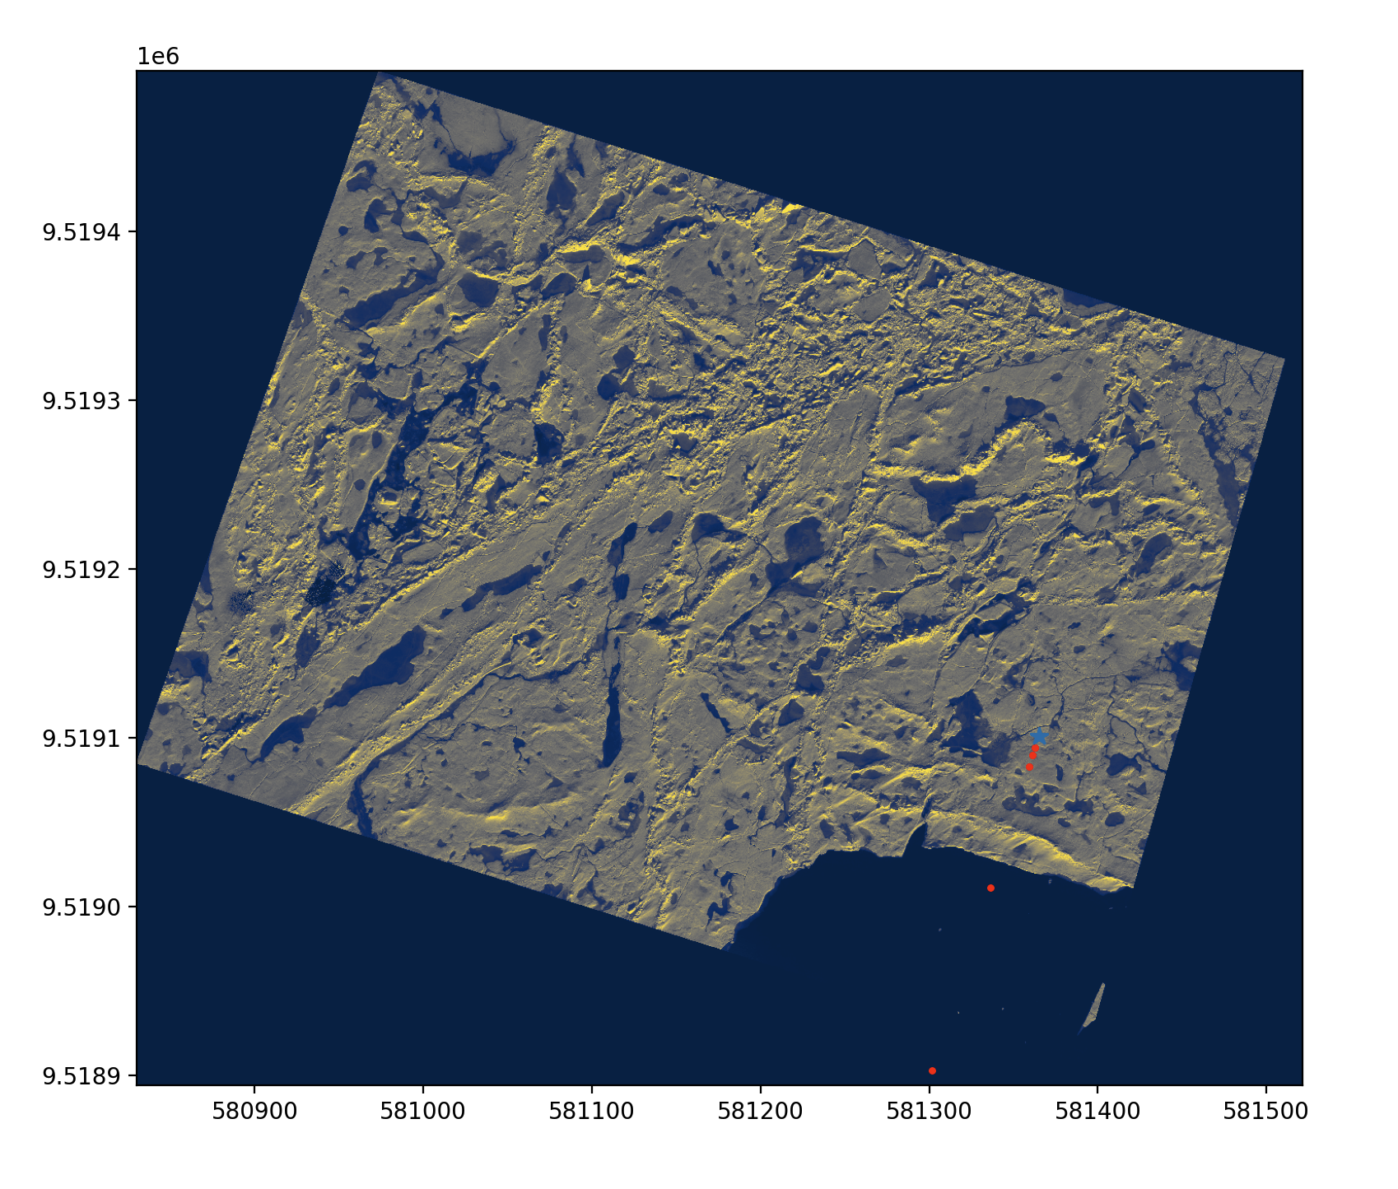

Slide 24
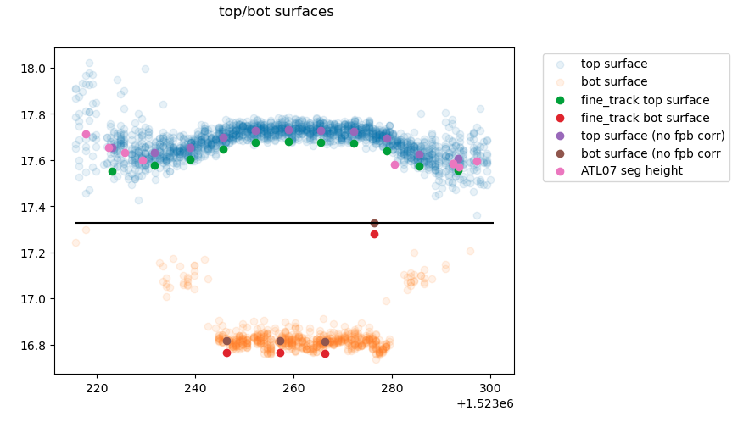
LARGE FPB correction -bad photon rate (shots = 1)

Slide 25
ATL05 updated
along track distances reset to ATL03 distances
previously relative distance w/ respect to delta_time(1)
pack BIF group and Ponds groups
BIF group packed to number of BIF segments found
previously lots of empty space at end
Pond group packed to number of BIF segments found
previously packed to ‘good’ pond segments
Can use time bounds to restrict processing
no beam selection option

